Slide 1


Neutrals Learning Center

Slide 2
What I want to do with this channel?
Java Angular Fullstack Developer.
Beginner Friendly content.
Learning Path
All Tutorials acompanied with Reference Materials
Tutorials have assesments in Googleclassroom

Slide 3



Levels - 1 Or Primary

Slide 4




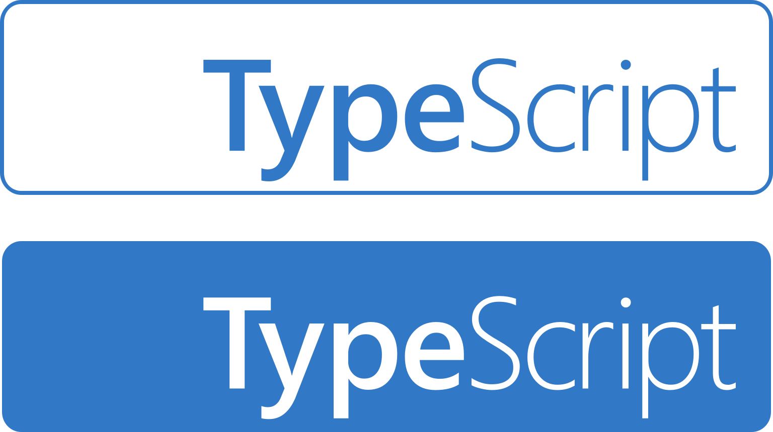
Levels - 2 Or Intermediate (UI Skills)

Slide 5

Levels - 3 (Backend Skills)
Springboot

Slide 6
Join Me In This Learning Journey

